Slide 1
Optimization of a simple Truss structure using Particle Swarm Optimization
Breno Hoelz Coscarelli (40032369)
Mech 6321
Project Presentation

Slide 2
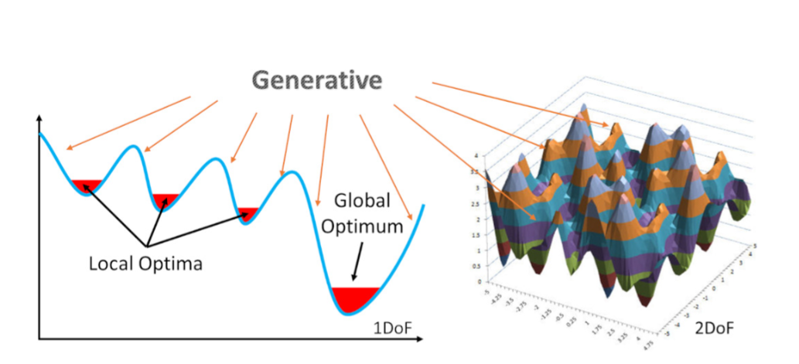
What is PSO
PSO utilizes a swarm of particles, each representing a potential solution, that navigate the search space by learning from their own experiences and the successes of neighboring particles.
It optimizes solutions iteratively by adjusting particle trajectories based on individual and collective findings, effectively solving complex multidimensional problems.
PSO
Fig 1: Kwok et al. 2022
Unintelligent Unity particles
Communicate to each other
Learn from each other
Creates complex behaviours
&
Notes:
Unreachable as a single organism.

Slide 3







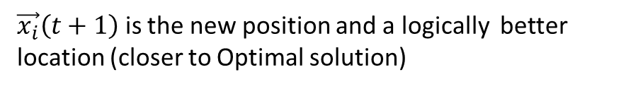




Intro to PSO
Personal Best of i particle
$$\vec{P_{i}}\left(t\right)$$
Swarm of particles
$$\vec{P_{i}}\left(t\right)−\vec{x_{i}}\left(t\right)$$
Position
$$\vec{x_{i}}\left(t\right)∈X$$
$$\vec{x_{i}}\left(t\right)$$
$$\vec{x_{i}}\left(t+1\right)$$
$$\vec{v_{i}}\left(t+1\right)$$
$$Particle i$$
Velocity
$$\vec{v_{i}}\left(t\right)$$
$$g\left(t\right)− \vec{x_{i}}\left(t\right)$$
$$g(t)$$
$$\vec{v_{i}}\left(t\right)$$
Overall Best of all particles in the swarm
$\vec{x_{i}}\left(t+1\right)$ is the new position and a logically better location (closer to Optimal solution)
Notes:
Particle is the candidate solution
Position: One dimension is scaler value. Actual position
G(t) Best of all particles in the swarm note not a vector

Slide 4

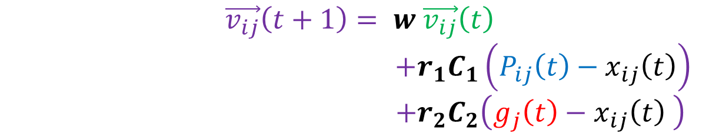









Updating the position of PSO
$$\vec{P_{i}}\left(t\right)$$
$$\vec{P_{i}}\left(t\right)−\vec{x_{i}}\left(t\right)$$
Updating the position
$\vec{x_{i}}\left(t+1\right)$ = $\vec{x_{i}}\left(t\right)+\vec{v_{i}}\left(t+1\right)$
$$\vec{x_{i}}\left(t\right)$$
$$\vec{x_{i}}\left(t+1\right)$$
Updating Velocity
$$\vec{v_{i}}\left(t+1\right)$$
$$\vec{v_{i}}\left(t+1\right)= w \vec{v_{i}}\left(t\right)+C_{1}\left(P_{i}\left(t\right)−x_{i}\left(t\right)\right)+C_{2}\left(g\left(t\right)−x_{i}\left(t\right) \right)$$
$$g\left(t\right)− \vec{x_{i}}\left(t\right)$$
$$g(t)$$
But this is a very simplified version of PSO, if we look at the equations written by Eberhart and Shi in 1998
$$\vec{v_{i}}\left(t\right)$$
Inertia Component
$$\vec{v_{ij}}\left(t+1\right)= w \vec{v_{ij}}\left(t\right)$$
$+{r_{1}C}_{1}\left(P_{ij}\left(t\right)−x_{ij}\left(t\right)\right)$
$+{r_{2}C}_{2}\left(g_{j}\left(t\right)−x_{ij}\left(t\right) \right)$
Cognitive Component (private thinking of the particle itself)
Social Component (collaboration among the particles)
Acceleration Coefficients
$\vec{x_{ij}}\left(t+1\right)$ = $\vec{x_{ij}}\left(t\right)+\vec{v_{ij}}\left(t+1\right)$
Notes:
Vi sum of three components with real value coefficient
Very simple mathematical model yet very powerful tool to solve optimization problem
The particle swarm optimizer has been found to be robust and fast in solving nonlinear, non+differentiable . multi-modal problems
Therefore, it can be imagined that the search process for PSO without the first part is a process where the search space statistically shrinks through the generations.
resembles a local search algorithm
Inertia term = balancing the global search and local search
Can be implemented in any programing language

Slide 5
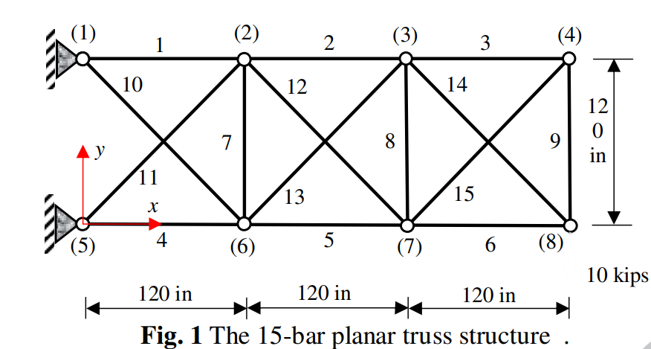



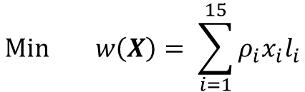

Problem statement
We have 8 nodes, each with 2 DoF so we have 16 DoF or 16 dimensions!
$$\operatorname{Min}{w\left(X\right)= \sum_{i=1}^{15}{ρ_{i}x_{i}l_{i}}}$$
Objective function:
Stress constrains:
$$\left(σ_{t}\right)≤25 (ksi)$$
X = Area Variables (cross section area of truss)
$$A_{i}, i=1,2,…,15$$
Geometry Values
Specific nodal coordinates of each member (8 in total) (x,y)
Fig 2: Gholizadeh, 2013
Young modules
$$E={10}^{4}(ksi)$$
$$ρ=0.1 (\frac{lb}{in^{3}})$$
Material density

Slide 6
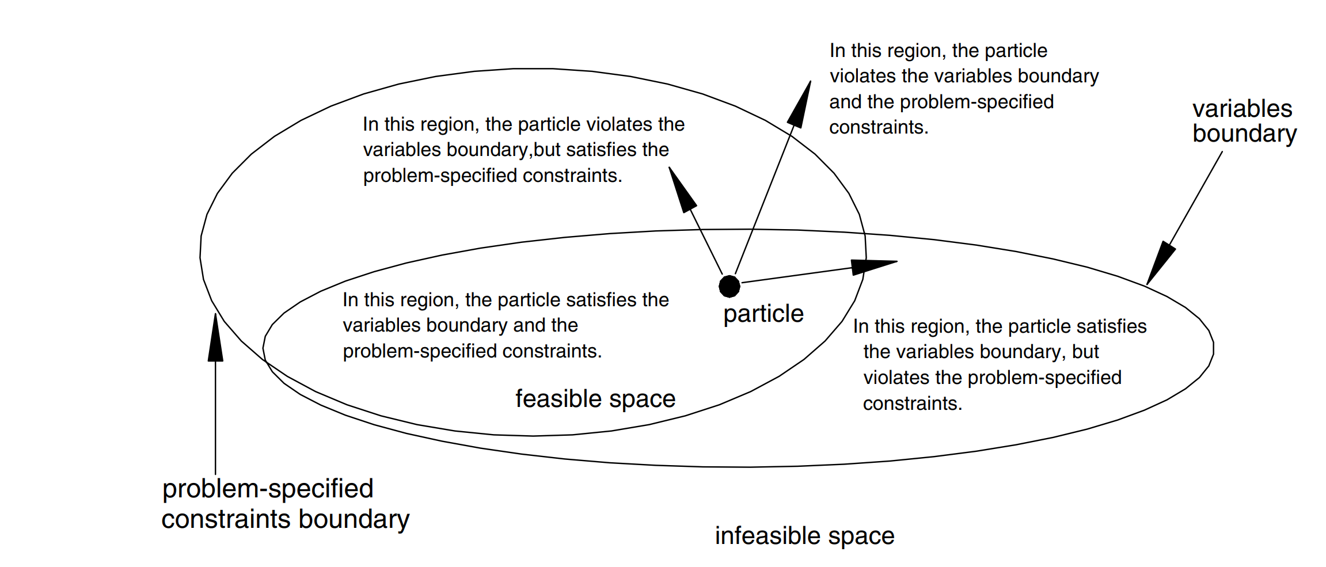
Particle leaves feasible reason but when it comes back it lands closer to the boundary
Fig 3. Gholizadeh, 2013
Notes:
The particles are initialized in the feasible region. When the optimization process starts, the particles fly in the feasible space to search the solution. If any one of the particles flies into the infeasible region, it will be forced to fly back to the previous position to guarantee a feasible solution. The particle which flies back to the previous position may be closer to the boundary at the next iteration. This makes the particles to fly to the global minimum in a great probability

Slide 7
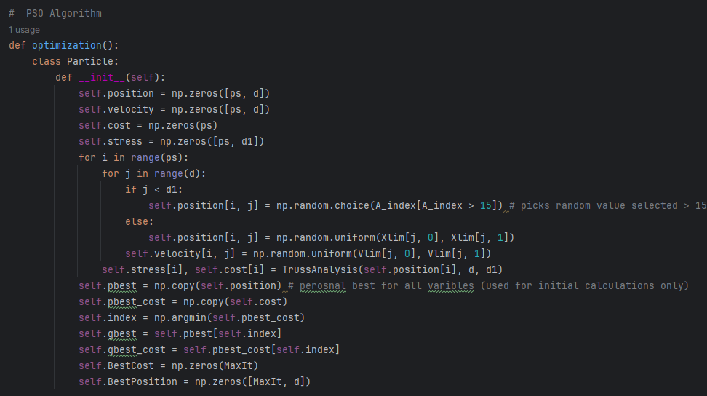
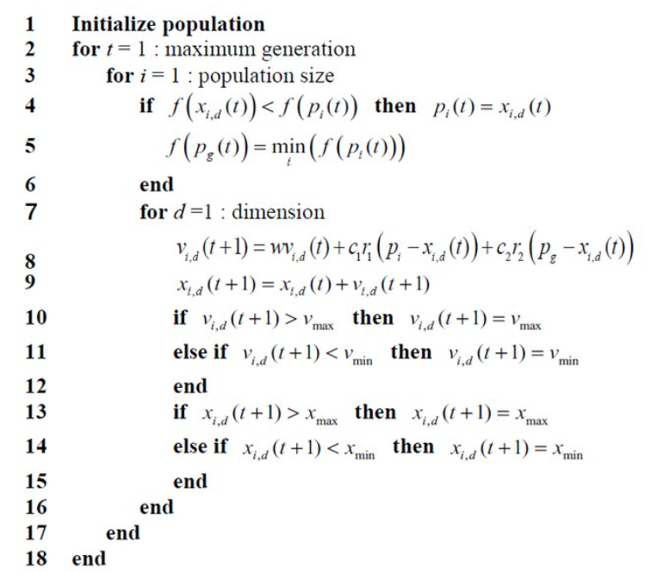
Solving Approach
PSO Python algorithm
Figure 4. Hou-Ping Dai et al.

Slide 8
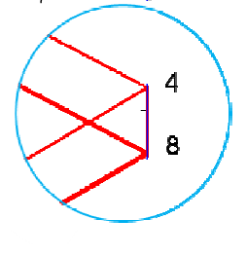
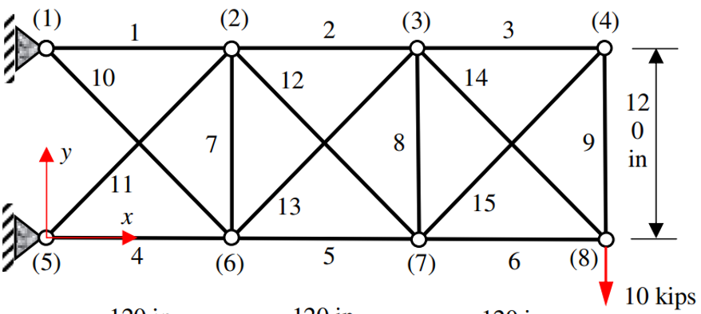
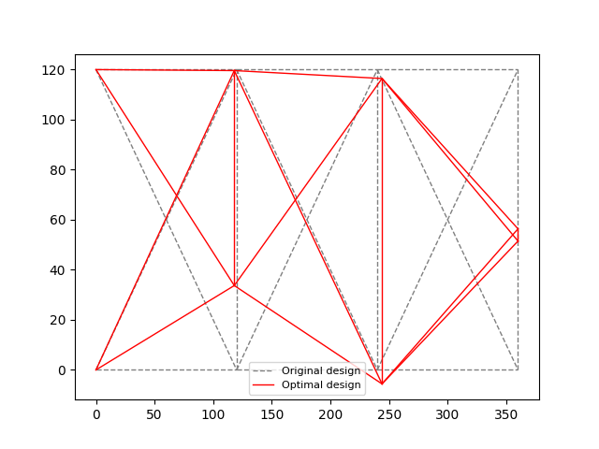
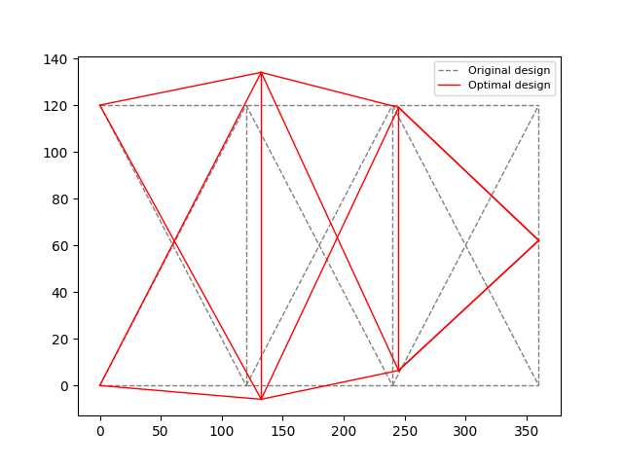
Results
Interesting design!
Weight = 92.424 lb
Weight = 93.810

Slide 9
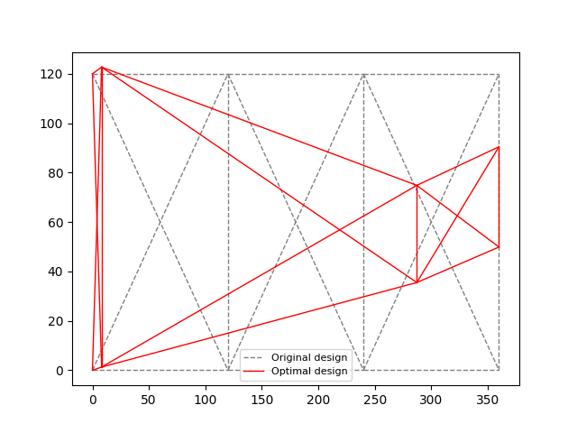
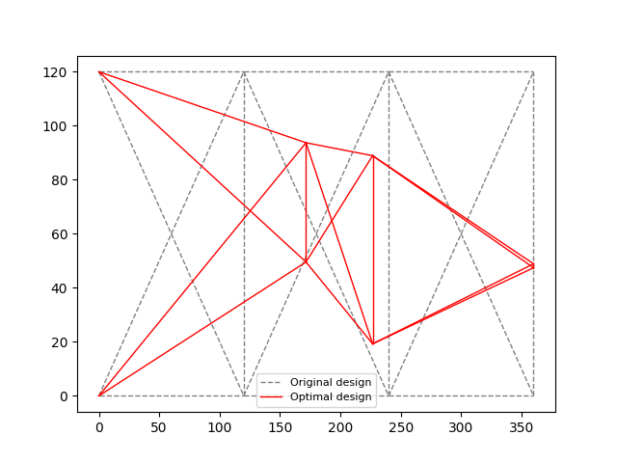
Results
Weight = 95.226
Weight = 176.137

Slide 10
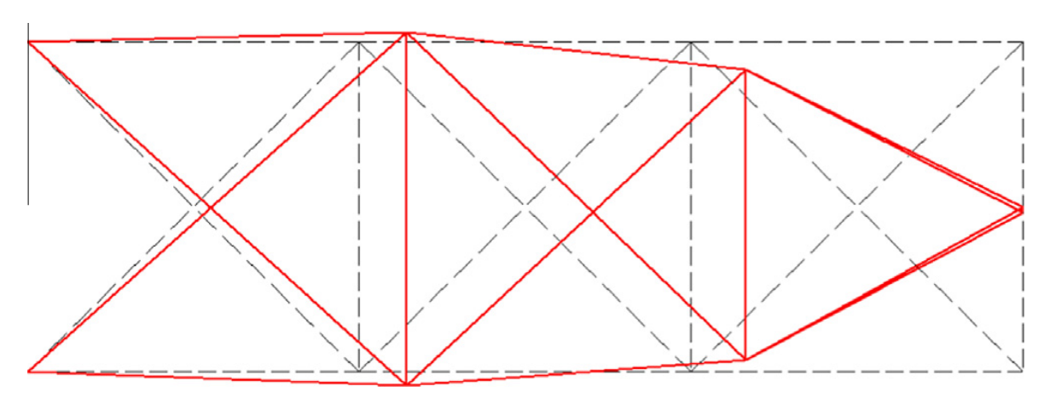
Most Optimal solution
Gholizadeh, 2013
This work based on [1,2]
Model | Weight (lb)
Gholizadeh, 2013 | 82.2344
This work | 81.5391

Slide 11
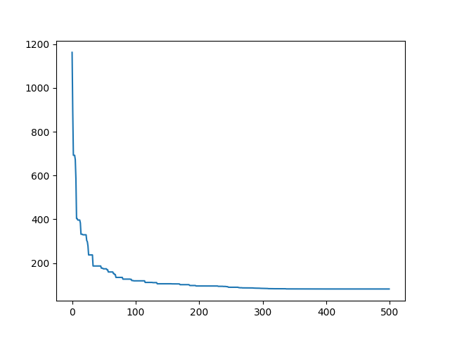
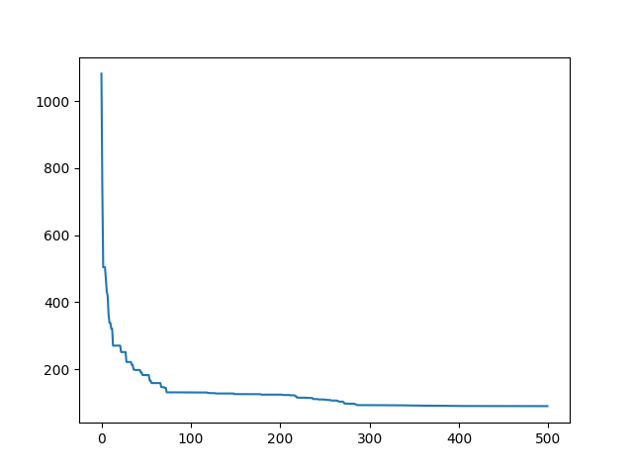
Convergence results
Notes:
Different Initial positions (random), will impact the results .

Slide 12

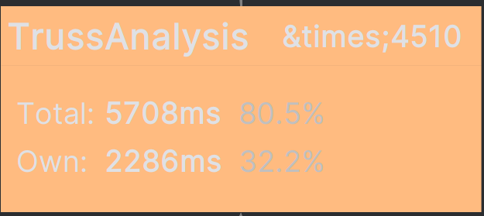
Python Call Graph (time stamp)
FEA Solver
80.5%
32.2%

Slide 13
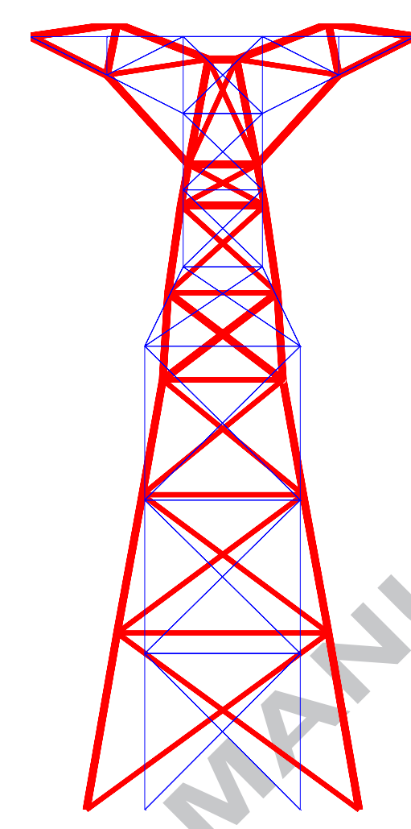
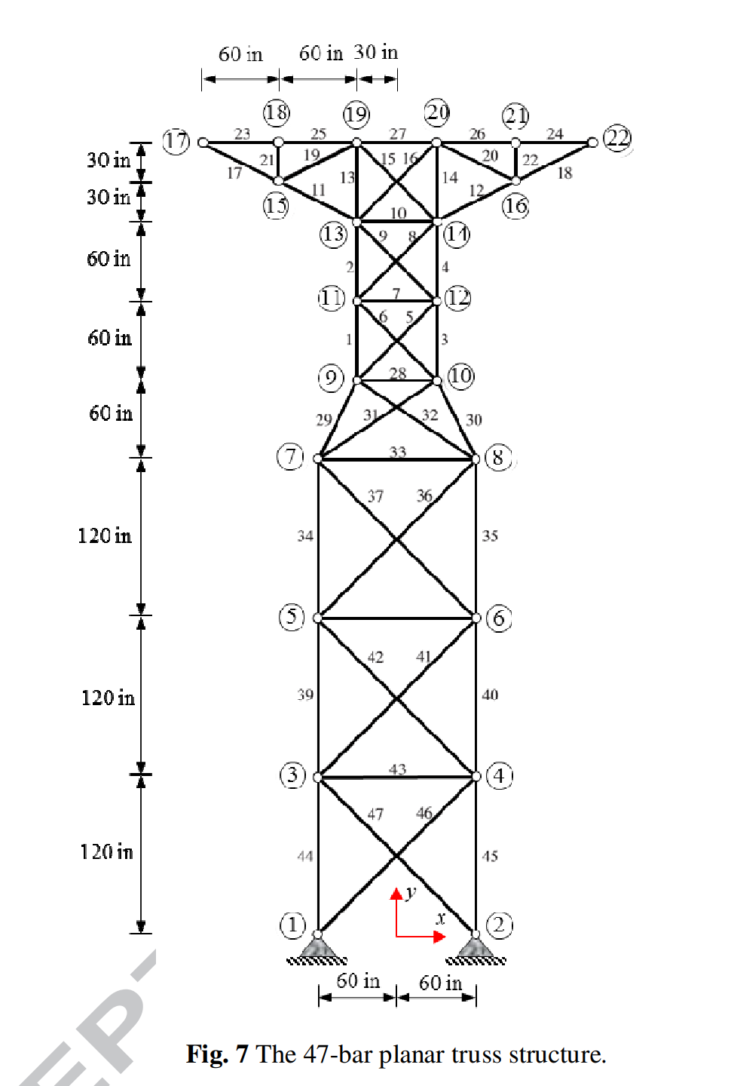
Real world applications
Power lines!
Fig 5. Gholizadeh, 2013

Slide 14
Conclusion
PSO converges to Optimal value very fast
The final solution is heavily dependent on the initial seeds (population) and Local vs global search [2]
The Inertia, Acceleration terms are chosen based on experience. (trial and error)
Limitations are that we cannot check stress levels (different failure modes can occur)

Slide 15
References
[1] L. J. Li, Z. B. Huang, F. Liu, and Q. H. Wu, “A heuristic particle swarm optimizer for optimization of PIN connected structures,” Computers &amp; Structures, vol. 85, no. 7–8, pp. 340–349, 2007. doi:10.1016/j.compstruc.2006.11.020
[2] Yuhui Shi and R. C. Eberhart, “Fuzzy adaptive particle swarm optimization,” Proceedings of the 2001 Congress on Evolutionary Computation (IEEE Cat. No.01TH8546). doi:10.1109/cec.2001.934377
[3] S. Gholizadeh, “Layout optimization of truss structures by hybridizing cellular automata and particle swarm optimization,” Computers &amp; Structures, vol. 125, pp. 86–99, 2013. doi:10.1016/j.compstruc.2013.04.024
[4] T. H. Kwok, “Improving the diversity of topology-optimized designs by swarm intelligence,” Structural and Multidisciplinary Optimization, vol. 65, no. 7, 2022. doi:10.1007/s00158-022-03295-w

Slide 16

Any questions?

